Slide 1

Branch and Bound

Slide 2
General algorithm used for optimization
Splits a problem set into two or more smaller sets, i.e. Branching
Uses a “bound” to rule out specific solutions to a problem
Can give an optimal solution without checking every single solution.
The branch-and-bound design strategy is very similar to backtracking
Like backtracking, BnB uses the state space tree.

Slide 3
Branch and Bound refers to all state space search methods in which all children of the ENode are generated before any other live node becomes the E-Node.
Branch and Bound is the generalization of both graph search strategies, BFS and D-search.
A BFS like state space search is called as FIFO (First in first out) search as the list of live nodes in a first in first out.
A D-search like state space search is called as LIFO (last in first out) search as the list of live nodes in a last in first out list

Slide 4
Branch and bound vs backtracking
parameter | backtracking | BnB
approch | used to find all possible solutions available to a problem. When it realises that it has made a bad choice, it undoes the last choice by backing it up. It searches the state space tree until it has found a solution for the problem | used to solve optimisation problems. When it realises that it already has a better optimal solution that the pre-solution leads to, it abandons that pre-solution. It completely searches the state space tree to get optimal solution
Traversal | Backtracking traverses the state space tree by DFS(Depth First Search) manner | Branch-and-Bound traverse the tree in any manner, DFS or BFS.
Function | Backtracking involves feasibility function. | Branch-and-Bound involves a bounding function.
Problems | Backtracking is used for solving Decision Problem. | Branch-and-Bound is used for solving Optimisation Problem.
Efficiency | Backtracking is more efficient. | Branch-and-Bound is less efficient.
Applications | Useful in solving N-Queen Problem, Sum of subset. | Useful in solving Knapsack Problem, Travelling Salesman Problem.

Slide 5
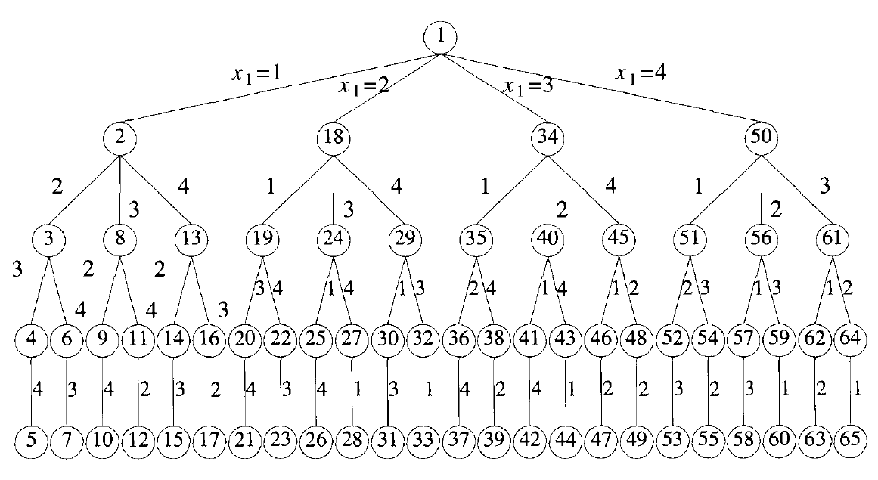

Slide 6
Branch and bound
Algorithm design paradigm
refers to all state Space search methods
all children of the E-node are generated before any other live node can become the E-node

Slide 7
3 types og Graph Search Strategies
● Breadth First Search(BFS)
● Depth First Search (D –search/ DFS)
Least Cost Search(LC Search)
● Breadth First
In BnB, BFS-like state space search will be called FIFO(First In First Out)
search as the list of live nodes is a first-in-first-out list (or queue).
DFS ( D-Search)
A D-search-like state space search will be called LIFO(Last In First Out)
search as the list of live nodes is a last-in-first-outlist (or stack).

Slide 8
● Bounding Function
help to avoid generation of subtrees that do not contain answer node

Slide 9
Example – General method- how FIFO BnB algorithm search state space tree for 4-queens problem

Slide 10









General method- how FIFO BnB algorithm search state space tree for 4-queens prob
queue
∗ Initially, there is only one live node ie- node 1;
* Means no queen has been placed on the chessboard
1
∗ This node is only live node in queue which will becomes E-node
Node 1 Expanded and generate all its children; 2,18,34,50 and added to queue
∗ represent a chessboard with queen1 in row 1and
columns1,2, 3,and 4 respectively
2 | 18 | 34 | 50

Slide 12
1
2
50
18
34
Q
 | Q
 |  | Q
 |  |  | Q
2 | 18 | 34 | 50

Slide 13


1
2
50
18
34
3
B
8
13
Q
 | Q
Q
 |  | Q
Q
 |  |  | Q
2 | 18 | 34 | 50 | 8 | 13

Slide 14




18
X1=2
29
19
B
24
B
 | Q
Q
 | Q
 |  | Q
 | Q
 |  |  | Q
2 | 18 | 34 | 50 | 8 | 13
34 | 50 | 8 | 13 | 29

Slide 16
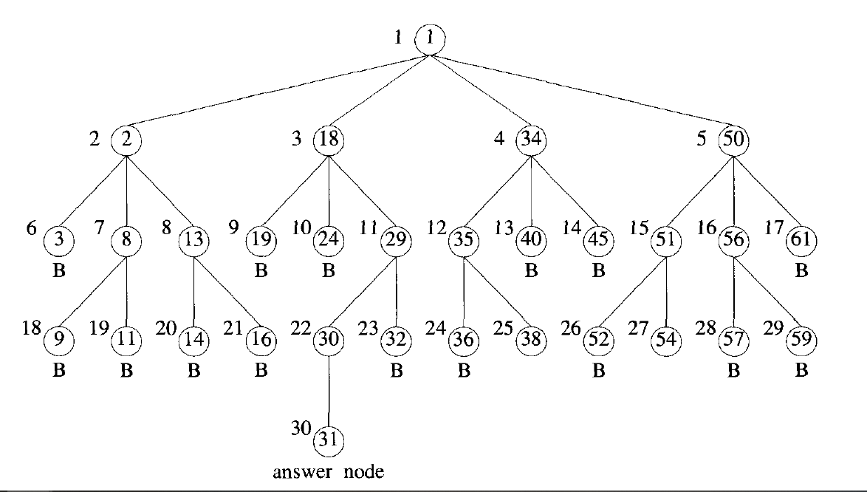

Slide 17
Then live nodes in the queue are 2,18,34,50
Next E node ,front of queue which is Node 2
Expand 2 and 3,8,13 generated
Node 3 killed immediately using bounding function
Node 8,13 added to queue of live nodes
Node 18 next E node and continue like this to find a solution

Slide 18
4-queens

Slide 19
19,24,29 generated
19,24 killed (bounding function)
29 addedto queue of live nodes
Node 34 E node
Thus create FIFO B B search
Nodes killed result of bounding function

Slide 20
Least Cost (LC) search
In FIFO and LIFO BB,selection rule for next E node is rigid
Not give any preference to a node that has very good chance of getting search to answer node quickly
Eg- in FIFO BnB, when node 30 generated, obvious that it will lead to answer node in just one move
But due to rigid structure of FIFO BB, all nodes generated before expanding node 30
Next E node selected basis on ranking function
If the ranking function assigns a better value to node 30 than the remaining live nodes, then node 30 will become the E-node as soon as it is generated, and we will get the solution at the very next step,
In LC search, we can be speed up searching by using the ranking function (.) for live nodes.

Slide 22
Example-LC search
C=∞
1
2
C=15
C=16
5
4
3
C=12
C=18
6
7
C=9
C=7

Slide 23
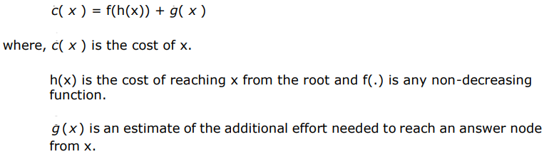
Ranking basically depends on the additional effort (cost) required to reach the answer node from the live node.
For any node x, the cost is determined by
(1) the number of nodes in the subtree x that need to be generated before the answer node is generated, or
(2) the number of levels from x to the answer node.

Slide 24
C(X) = cost of reaching the current node, X (E- node), from the root + the cost of reaching an answer node from X.
C(X) = g(X) + h(X)
h(x)=the cost of reaching a solution-node from X, not known.

Slide 25
Difficulty
to compute the cost at node x involve the search of the subtree at x For answer node.
Solution
so can rank nodes bais of an estimate function gˆ(·) instead of actually expanding the nodes
gˆ(x) be an estimate of the additional effort needed to reach an answer from node x

Slide 26

The N²-1 Puzzle Problem

Slide 27
8-puzzle problem

Slide 28
Given a 3×3 board with 8 tiles (every tile has one number from 1 to 8) and one empty space.
The objective is to place the numbers on tiles to match the final configuration using the empty space.
We can slide four adjacent (left, right, above, and below) tiles into the empty space.

Slide 29
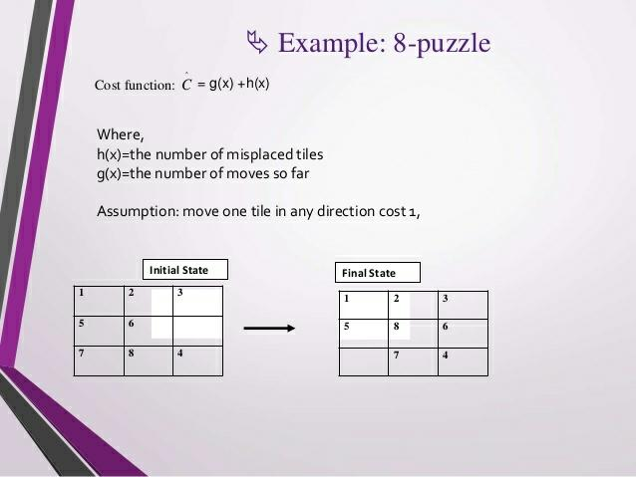

Slide 30
– Given an initial arrangement, transform it to the goal arrangement through a series of legal moves
only legal moves are one in which a tile adjacent to the empty spot(ES) is moved to ES
From initial state only four moves are possible
UP,DOWN ,LEFT, RIGHT

Slide 31
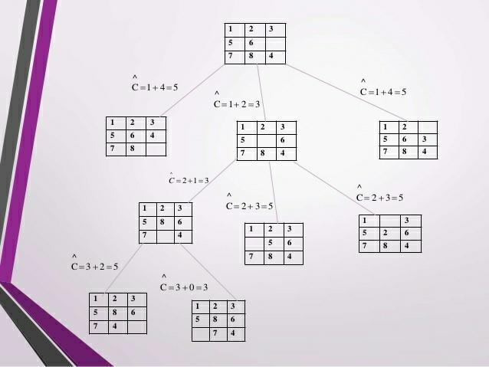
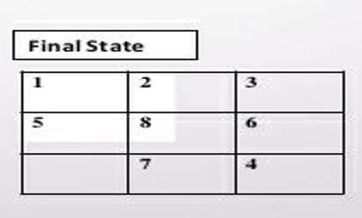
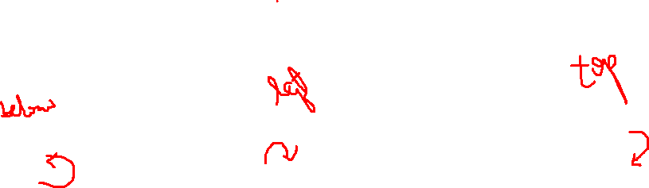

Slide 32
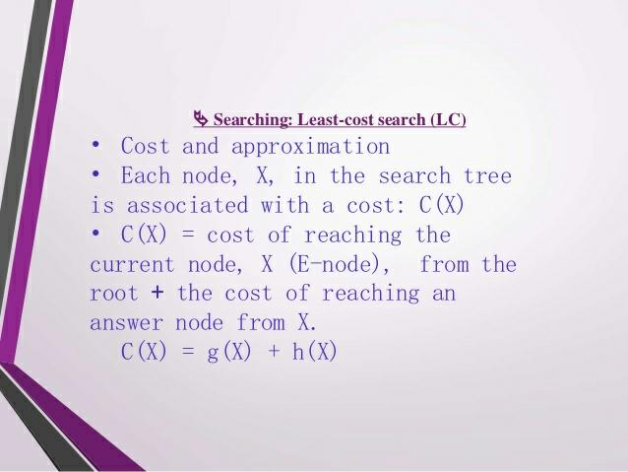

Slide 33


Slide 34
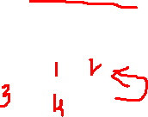

Slide 35
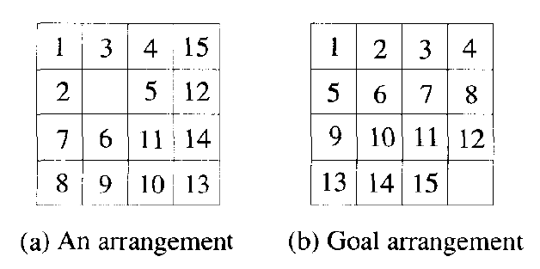
15 puzzle problem

Slide 36
